Slide 1
TOI Student Digital Strategy
Website Prototype Screenshots
Dec 2017

Slide 2


Slide 3
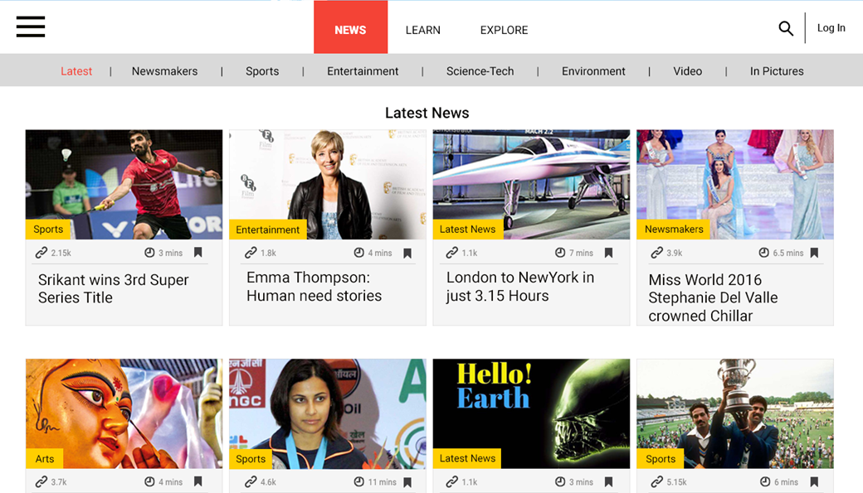

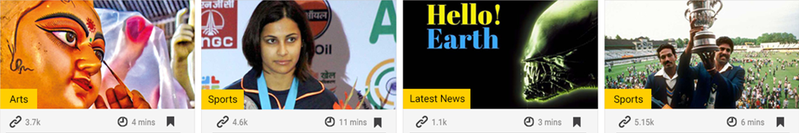
3 hr
Science-Tech
4.5
Webinar
5.0
5.0
Your Corner
Art
Sports
Sci-Tech
Sports
4.5
4.0
5.0
5.0

Slide 4
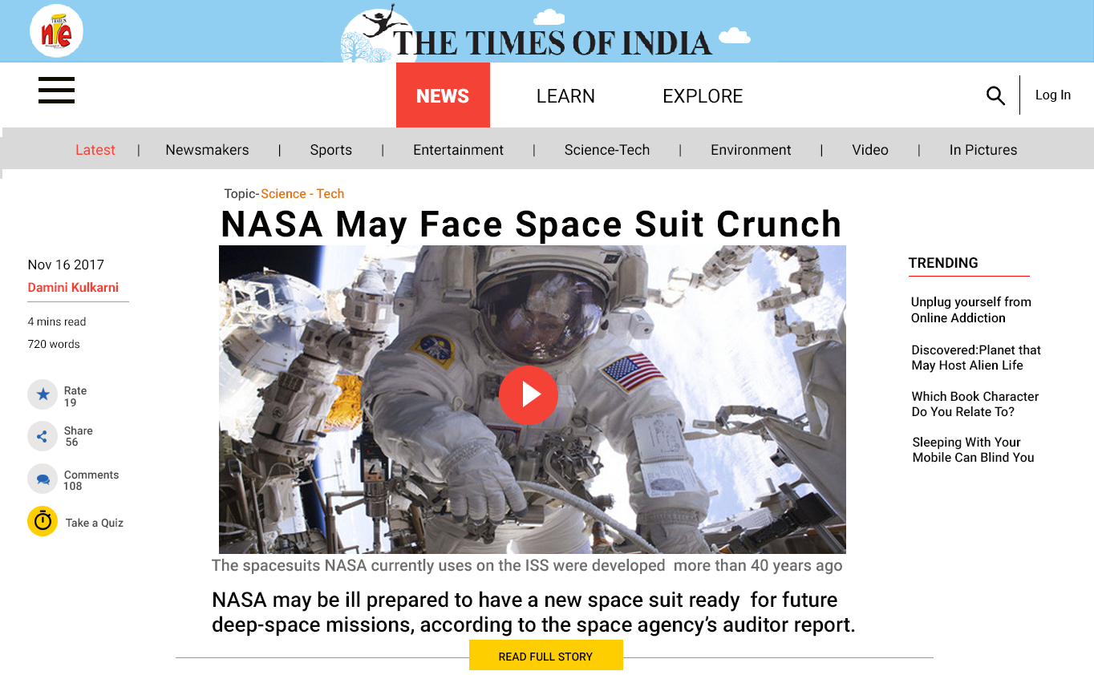
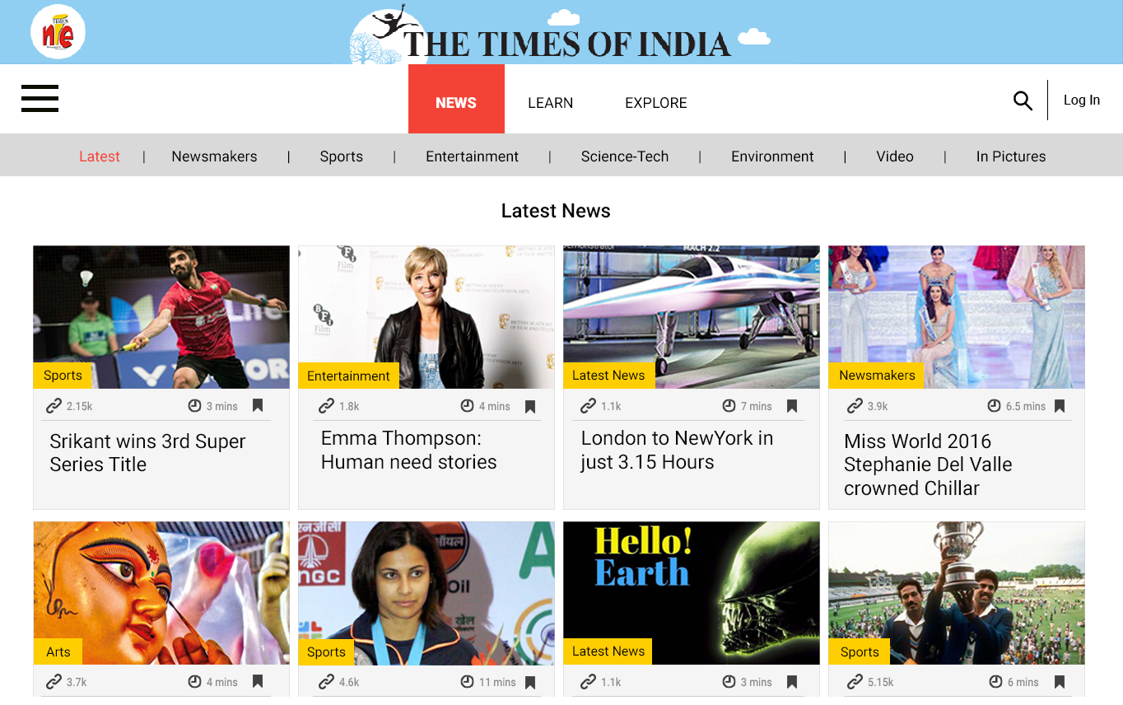
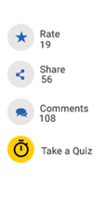



TRENDING
News: Discovered – Planet That May Host Alien Life
Quiz: Life outside the Earth
Explore: Which Book Character Do You Relate To?
Poll: Who Is Your Favourite Book Character?
4.2
Rate
Share
56
Comment
18
Take a Quiz
Take a Poll
Write

Slide 5
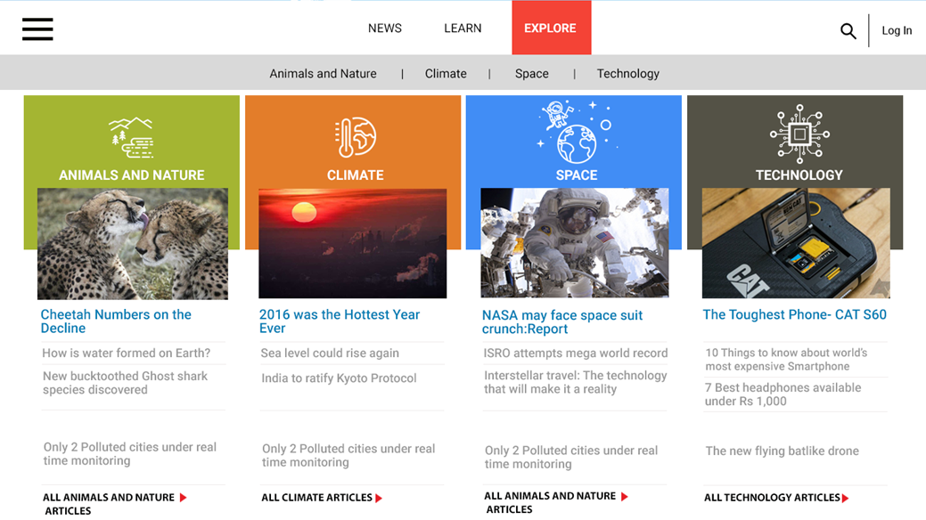


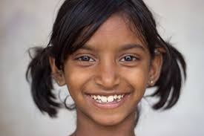
5.0
4.5
4.2
4.7
India Of My Dreams
by Shreya J
Your Corner
Victims of Anger
by Hardik K
Your Corner
Victims of Anger
by Roma R
Your Corner
Technology vs Human Relationships
by Shreya J
Your Corner

Slide 6
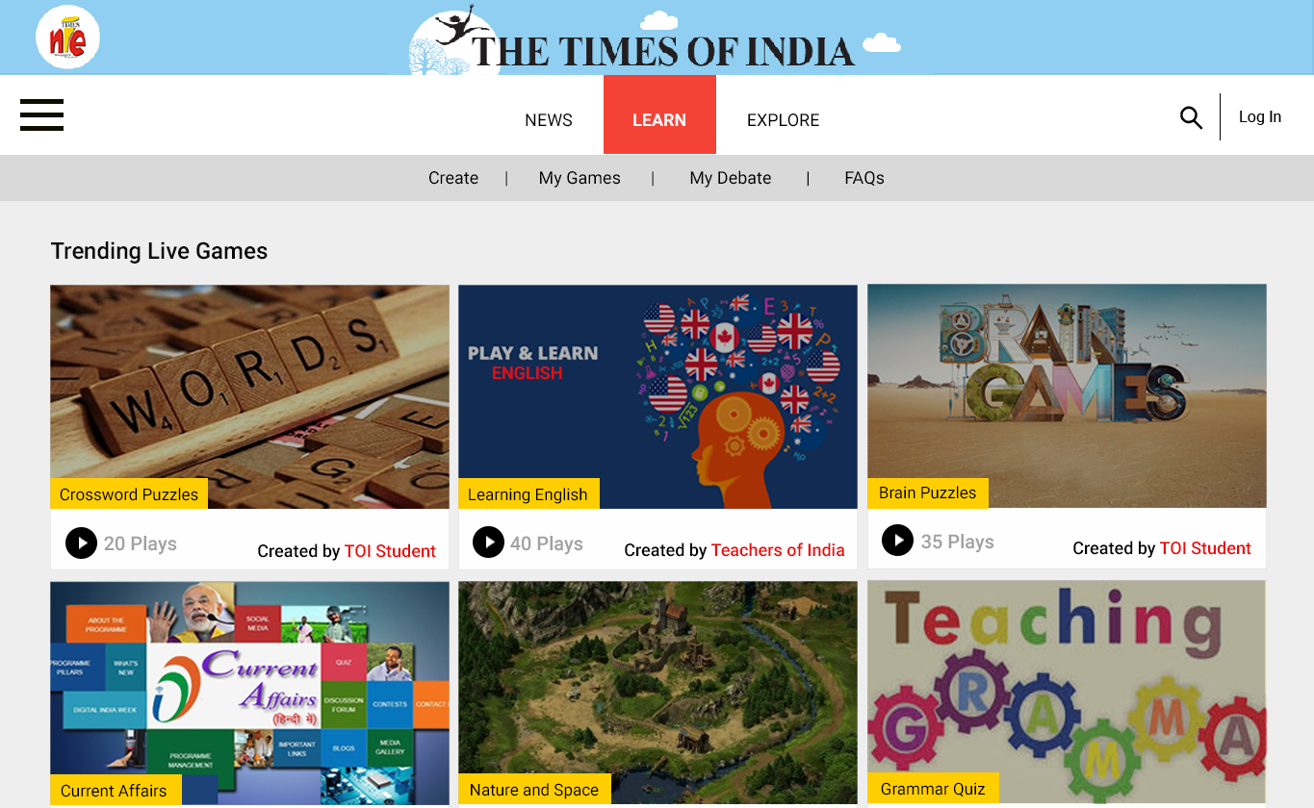
4.5
4.7
5.0
1 hr
41 min
4.7
Inter School Debate
4.5

Slide 7
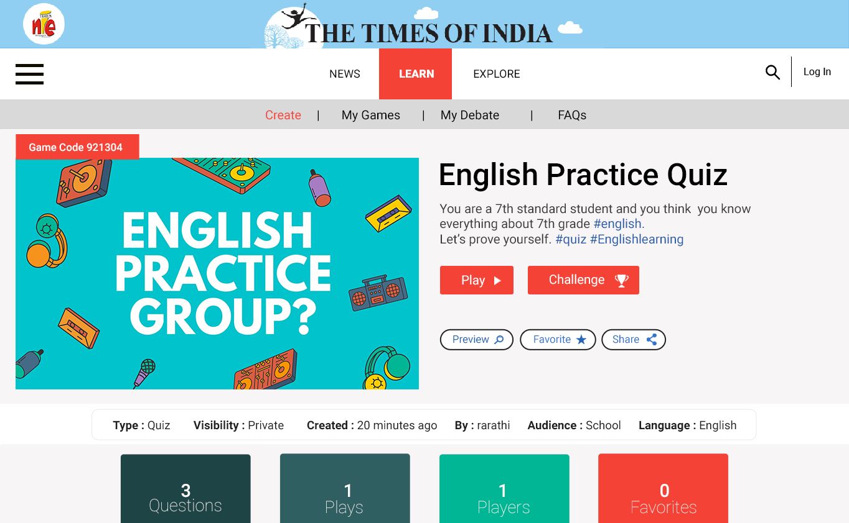

Slide 8
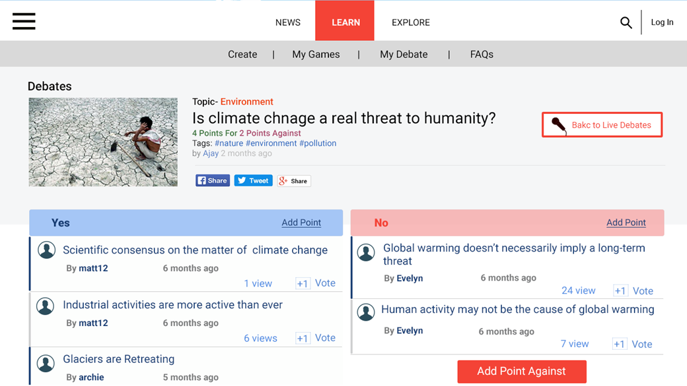
Vote For (42)
Vote Against (20)

Slide 9
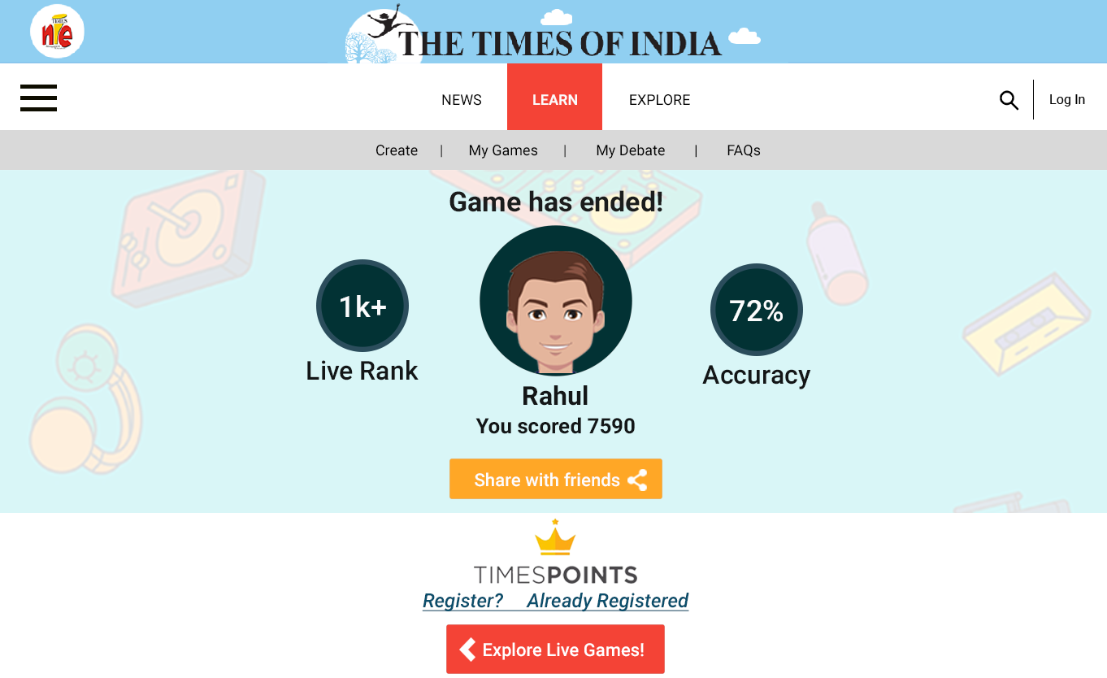
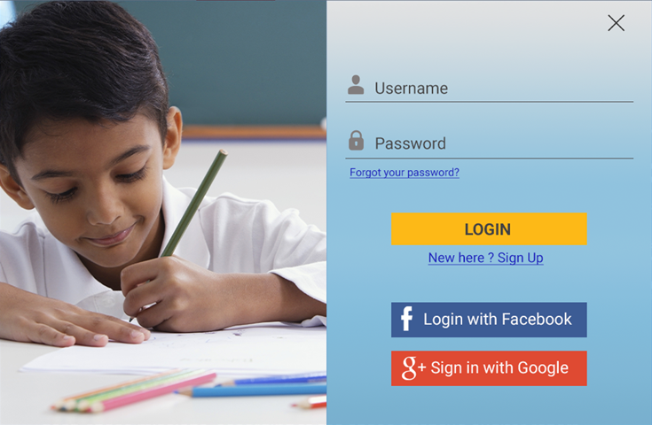


LOG IN
TO VIEW SCORE AND WIN REWARDS!

Slide 10
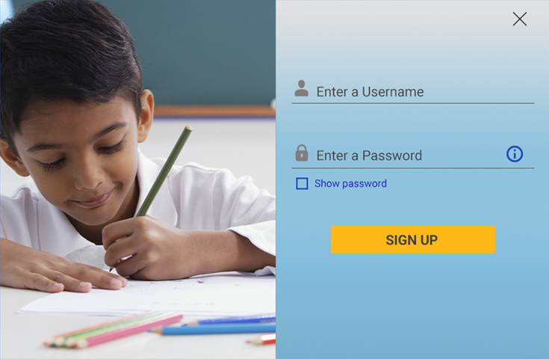
SIGN UP
TO VIEW SCORE AND WIN REWARDS!

Slide 11
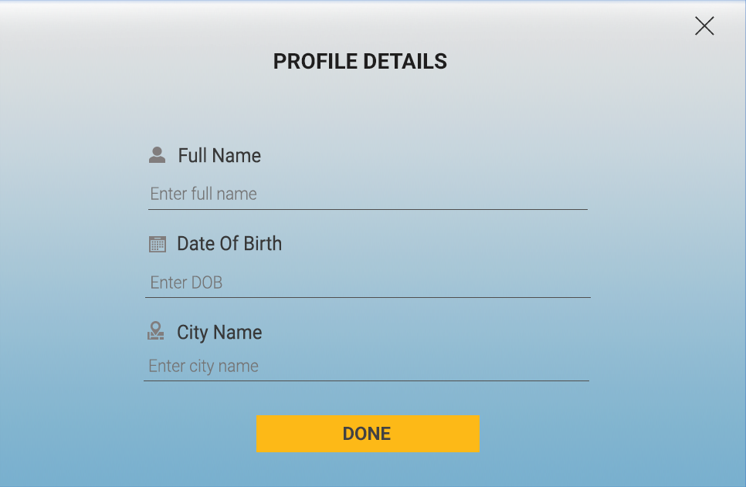

Slide 12
rarathi
1024 pts
Points!
Replay
Share

Slide 13

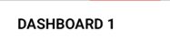

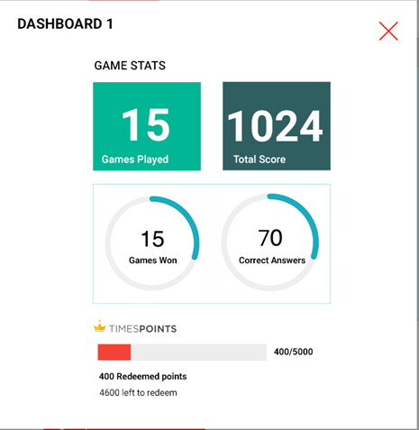
rarathi
1024 pts
My Wall
Notifications
My Network Activity
People I am following
People following me
My Activity
Articles
Comments
Shared
Saved
Points!
Replay
Share

Slide 14

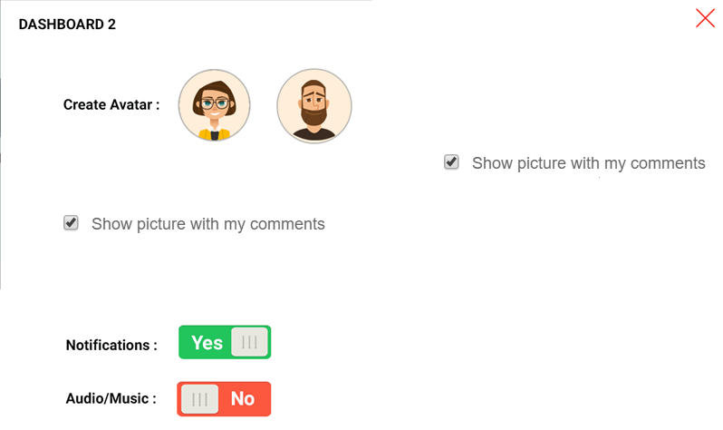




rarathi
1024 pts
Create Avatar:
OR
Upload photo:
Show picture with my comments
Make my profile public:
Notifications:
Audio/ Music:
Points!
Replay
Share
SAVE

